Slide 1
Early breast cancer detection-device
Mansoura university faculty of computers and information department of Bioinformatics
Level 3
Real-Time course

Slide 2
Team information :
May Rizk ibrahim | mairizk99@gmail.com
May allaa abo ghanem | mayalaa881@gmail.com
Hala hamdi el said mohamed | hamdiihala12@gmail.com
Esraa Mahmoud shalaby | Esraa.shalaby77@gmail.com
Ayatollah elghali assran | ayahelghaly@gmail.com
Reham fekry abass | rehamfkry@gmail.com
Rewan Samir | Samirrewan335@gmail.com
Hajar Mohamed elsharawe | Hajr.mohamed195@gmail.com

Slide 3
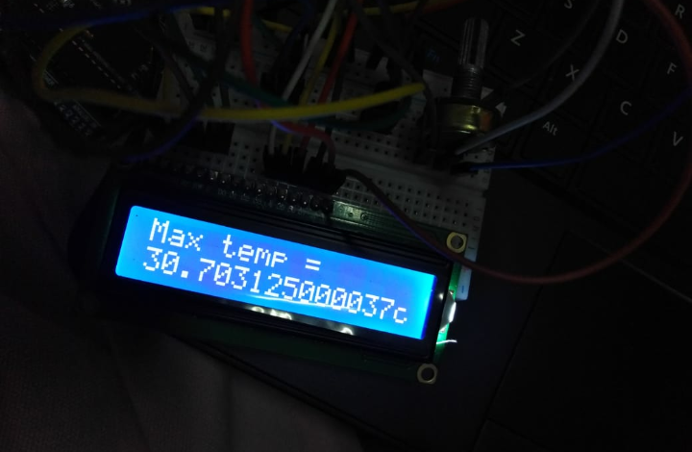
Prototype :

Slide 4
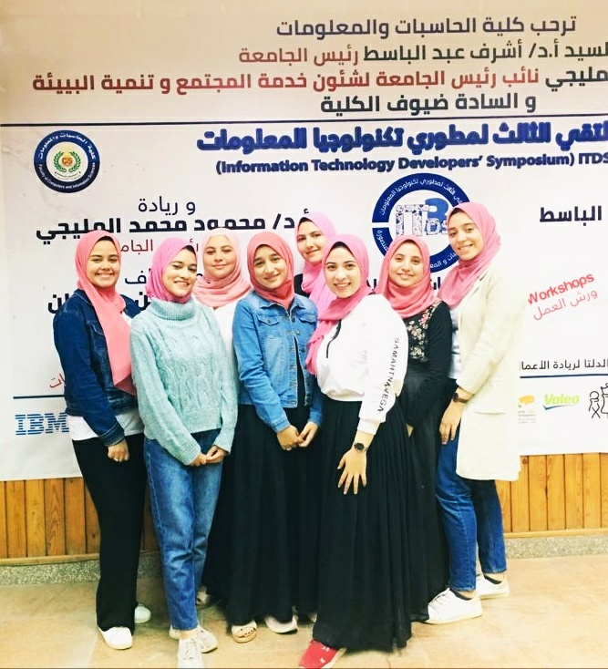
P-TEAM:

